Slide 1
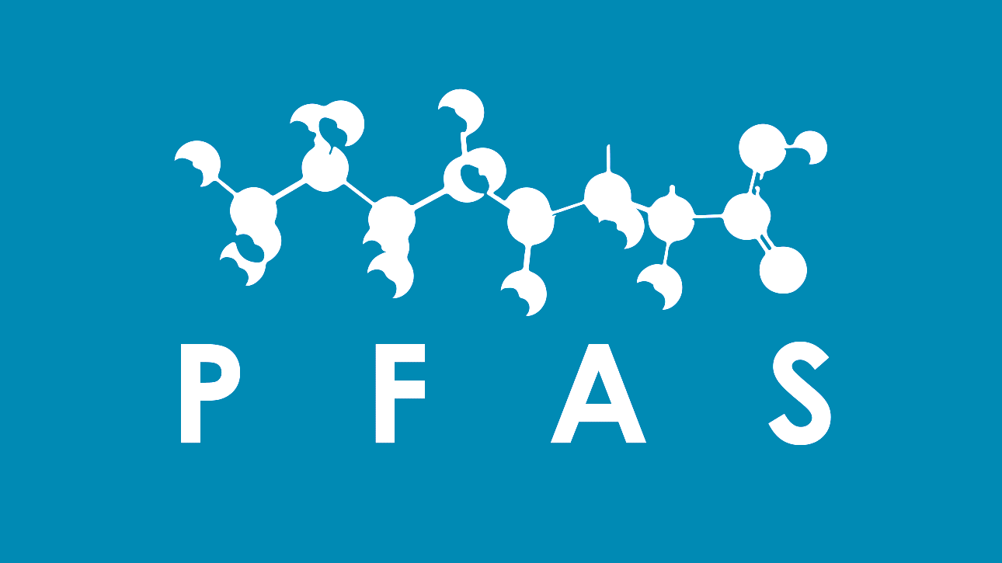
PFAS AWAY
PFAS ANALYSIS AND INTERVENTION
MOULTON NIGUEL WATER DISTRICT
MELISSA SALAZAR

Slide 2
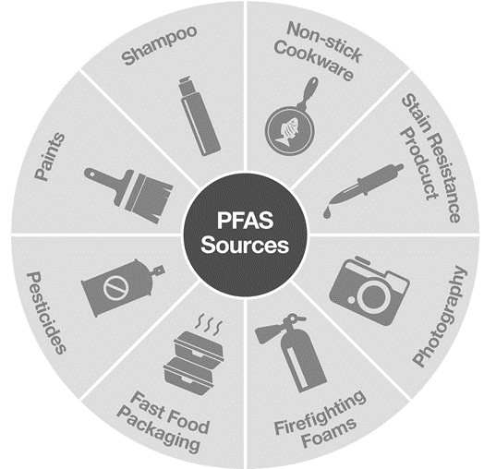
WHAT IS PFAS & WHY IS IT IMPORTANT?
PFAS stands for Per- and polyfluoroalkyl substances and is a family over 4,000 man-made chemicals
They are unique for their BIOPERSISTANT quality
In the recent news in California PFAS has been found in over 300 water sources including drinking water sources
Thank you to OCWD for providing a dataset that started this journey of analysis

Slide 3
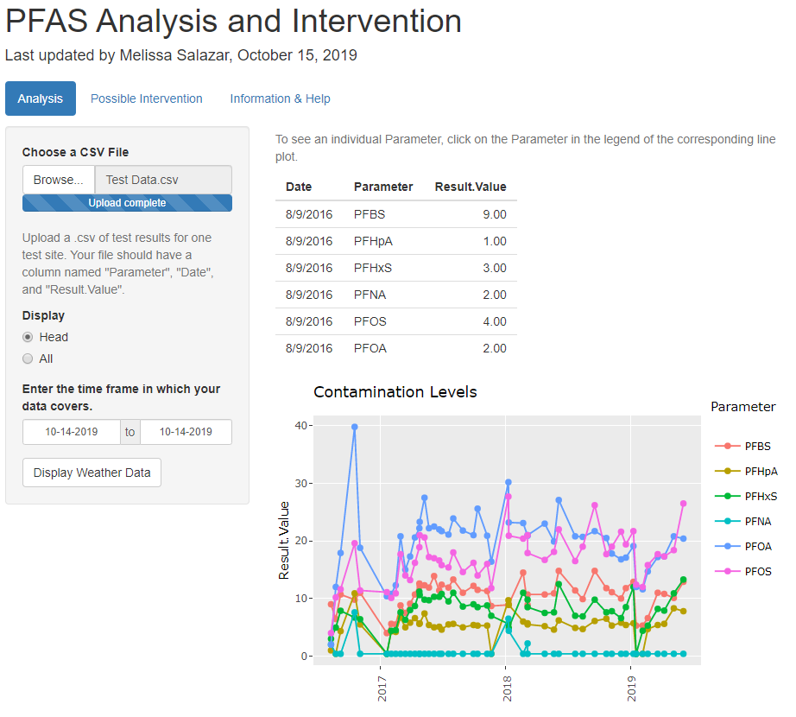
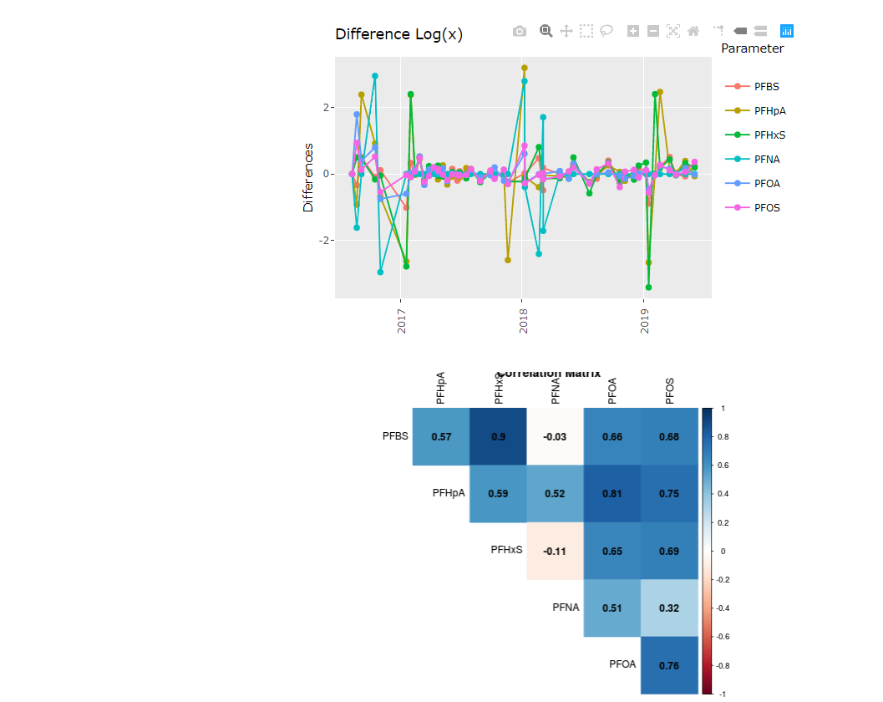
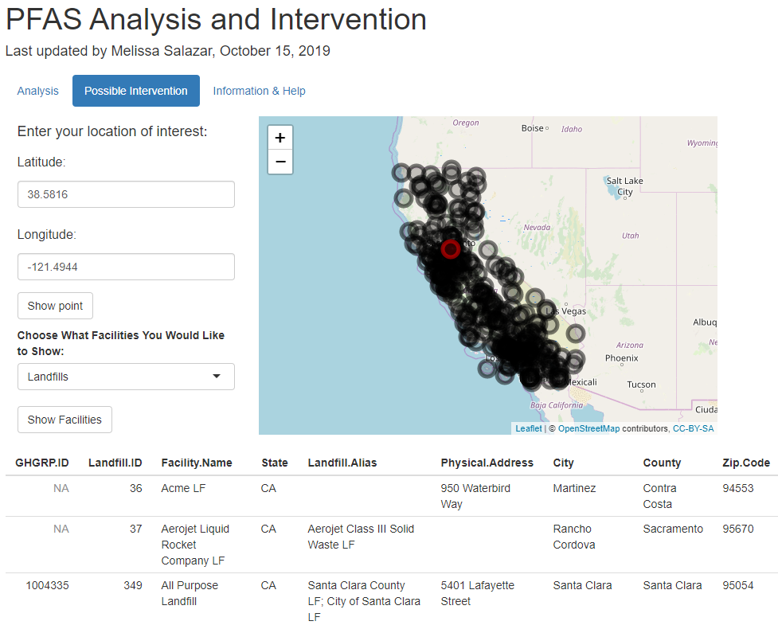
In the Analysis portion of the app, the user can upload a .csv of their data and the app will create a handful of visualizations for a quicker analysis
In the Intervention portion of the app the user can enter the latitude and longitude of their test site and choose to see landfills and or other facilities within a given radius to start implementing intervention measures

